Slide 1
Database Presentation
By: Parth Gandhi and Juan Alvarado

Slide 2

MakeMyTrip.com Travel Agency
My database is about travel agency based in Hyderabad, India which books flights and hotels for customers both in India and internationally.
For this database, I focused only on USA operations of my business.
My database contains tables such as employees, customers, membership, order, flight booking and hotel booking.

Slide 3

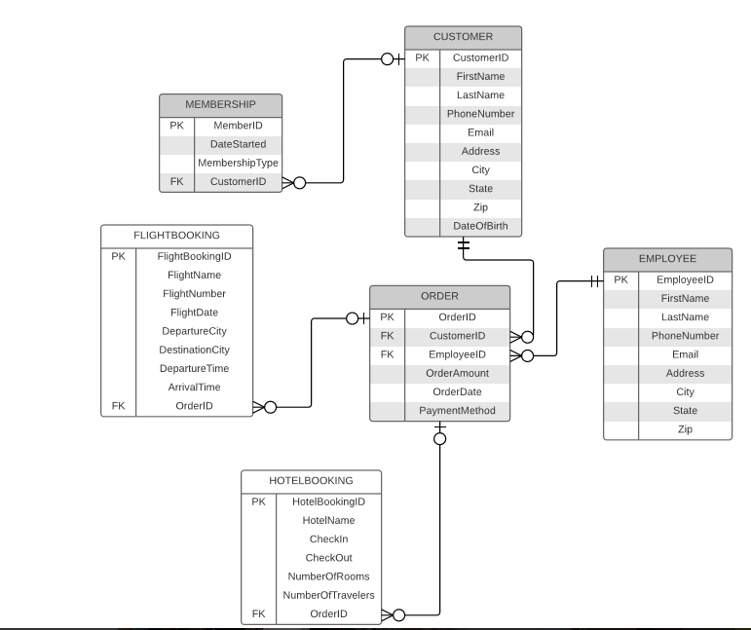
Parth P.3 Database Diagram

Slide 4

EA Sports Database
My Database is about a video game company.
The database was created in order to help the gaming company keep track of the orders, inventory, customer, and employees.

Slide 5
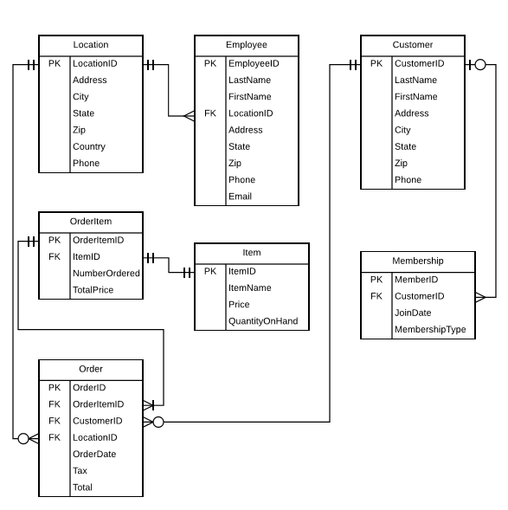
Juan P.3 Database Diagram

Slide 6
Struggles
Had no idea how my business suppose to use the database.
Making appropriate modality and cardinality
Had to fix Juan P.3 before going to P.4
Understand and taking over Parth database
Working on totally different database that you have no idea about
Didn’t knew how to create a table
Didn't know what information to put in P.5
Small and silly mistakes makes a error.
For example: Writing 2/29/13 for join date gives error since 2013 wasn't a leap year.
Thinking you got everything right but you are wrong.

Slide 7

Success...
Felt better after creating database diagram that made sense.
Clearing any doubts I had about my partners database by consulting with him
Getting the message
1 Row Affected / successfully
Successfully running the query

Slide 8

Lessons Learned:
Starting early
How to creating a database from scratch
Time management
Learning to adapt to the curve ball after P.3

Slide 9
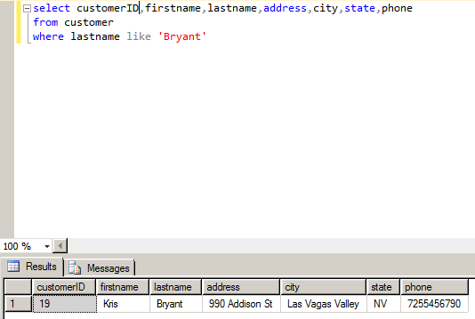
Example of Query:

Slide 10


